Slide 1
Coaches Pre Season Meeting
May 1st, 2018

Slide 2
Agenda
Welcome
Website – New features
Uniforms
Partnerships
Registration
Player Cards & Mobile App
Operations
Rule Proposal
Discipline process
Any other business
Cup draws

Slide 3
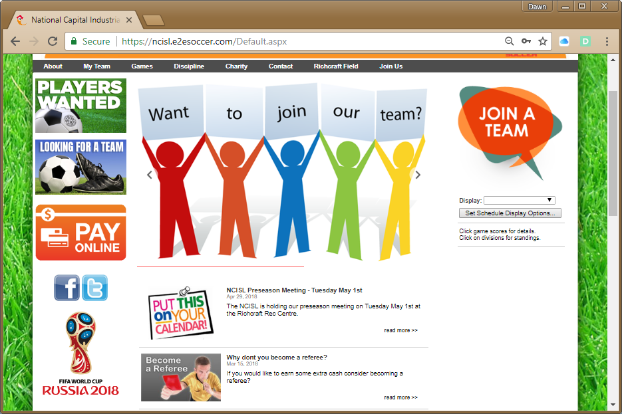
New Features
NCISL has created a Bulletin Board for members to use for look for a team or advertise for players.

Slide 4
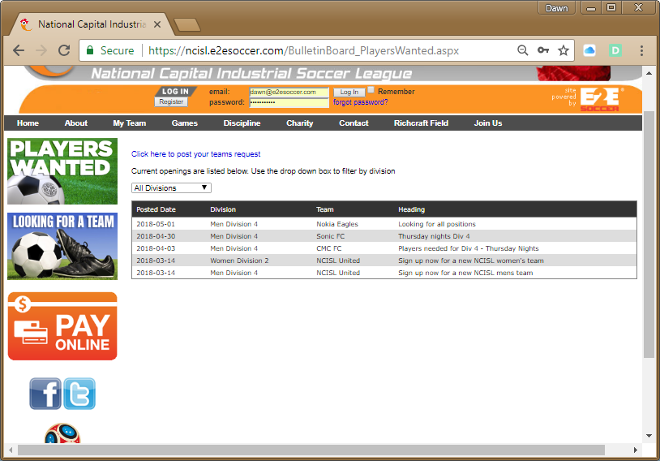
To advertise for players, click on the link.
Once approved by the league, people will be able to view your posting

Slide 5
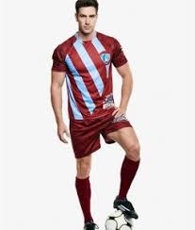
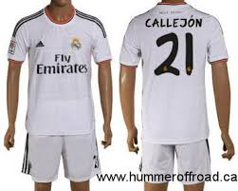
Uniforms
All outfield players MUST wear the same colour shorts and socks.
Jerseys must be the identical with numbers on the back.

Slide 6
2018 Outdoor Calendar
1st May Pre Season Coaches Meeting
14th May Exhibition games start
21st May League season starts
7th August Presidents Cup Semi-Final
9th August Challenge Cup Semi-Final
23rd August Presidents Cup Final
23rd August Challenge Cup Final
30th August League season ends
30th September Payment balance deadline

Slide 7
Ottawa Fury FC
The NCISL and Ottawa Fury FC have partnered up for the 2018 season.
For each Fury FC home game the NCISL will be giving away 2 pairs of tickets.
Next home game is May 2nd vs New York Red Bulls
Visit www.ottawafuryfc.com/single-game-tickets to order your tickets.

Slide 8
Player Registration Process
1. Player registers on NCISL site
League Admin registers player in AIMs. This takes 24 hours.
Player can now apply for EODSA Player Card

Slide 9
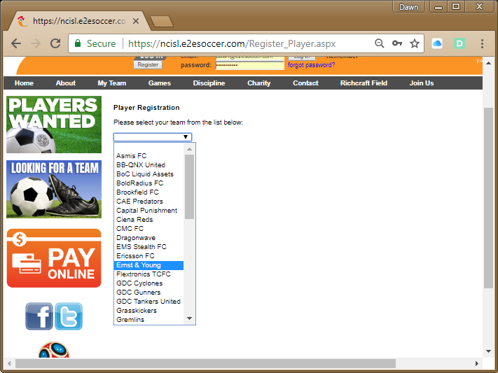
Player Registration
Players MUST register on the NCISL website.
Click Register
Choose your team from the drop down menu.

Slide 10
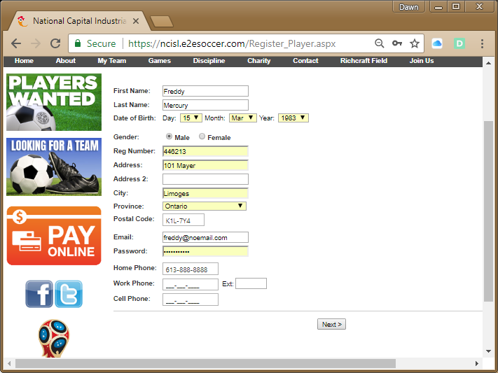
Player Registration
All information must be filled out (cell and work opt.)
Registration number is your OSA number as it appears on your player card.

Slide 11
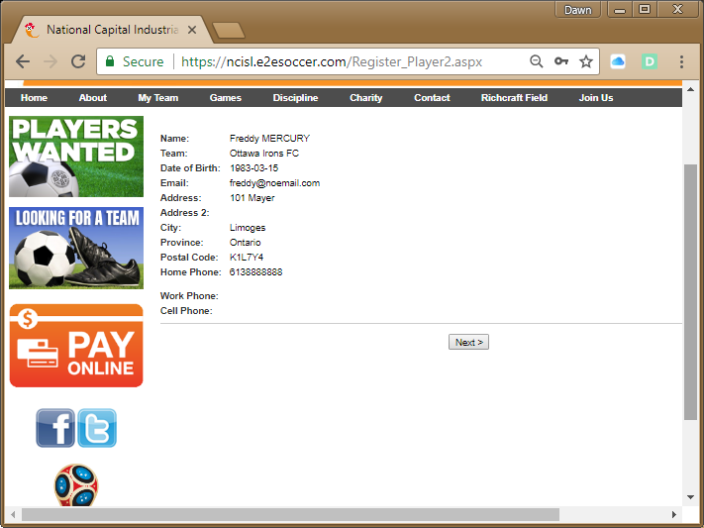
Player Registration
Confirm your player registration information is correct.

Slide 12
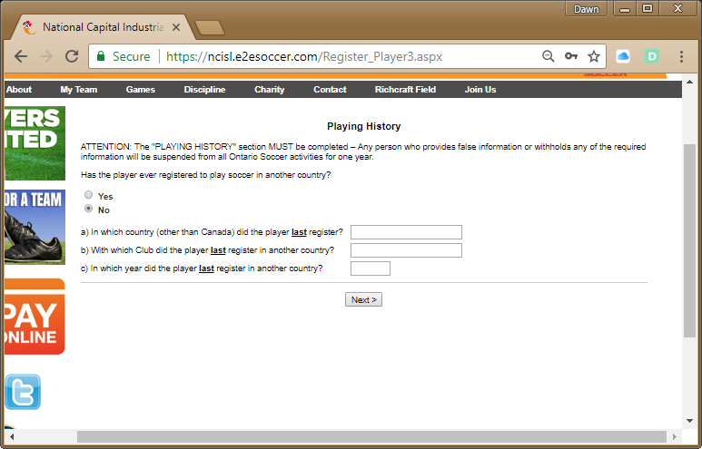
Player Registration
This section must be completed if you have ever registered to play soccer in another country.

Slide 13
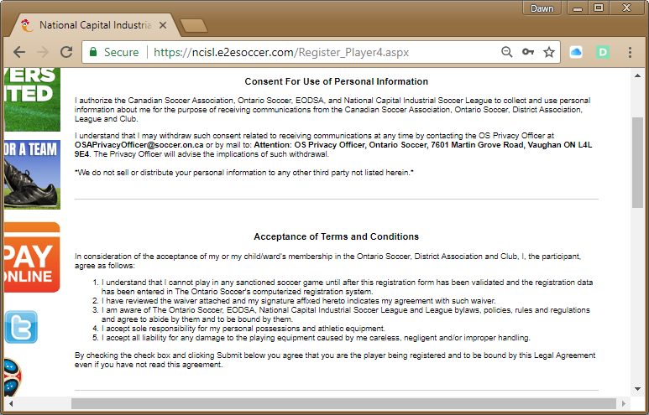
Player Registration
Your consent, waiver and acceptance are required to proceed.

Slide 14
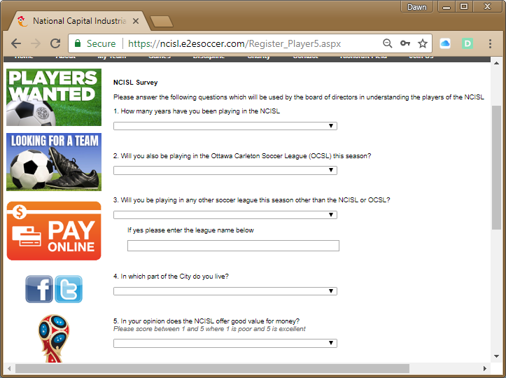
Player Registration
New this year is the player registration survey.
Purpose is to help improve the league and find out more about our members

Slide 15
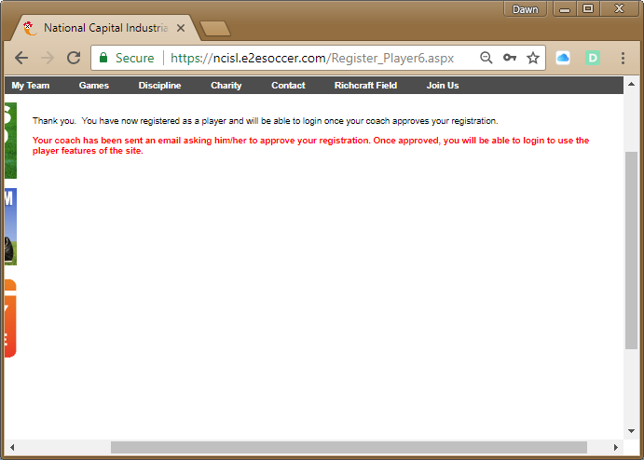
Player Registration
You are now registered with the NCISL

Slide 16
Player Identification Cards
Reminder – EODSA Player Cards – Only Acceptable ID.
To prove that a player has been registered properly, all players must bring with them a valid Ontario Soccer (OS) player photo card (available from the EODSA office). Valid meaning not expired.
The NCISL does not pay for OS cards.
The website will only allow registered players to be added to the game sheet.
Hand-written names on the game sheet will be inspected by the league office to confirm player’s registration.

Slide 17
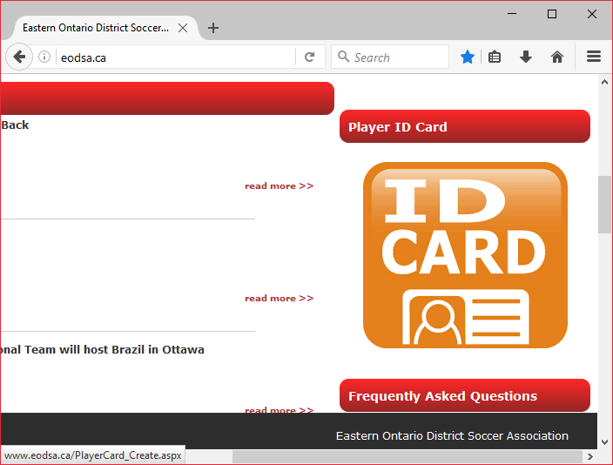
How to Apply for an EODSA Player Card
Visit www.eodsa.ca
Click on the link for ID Card

Slide 18
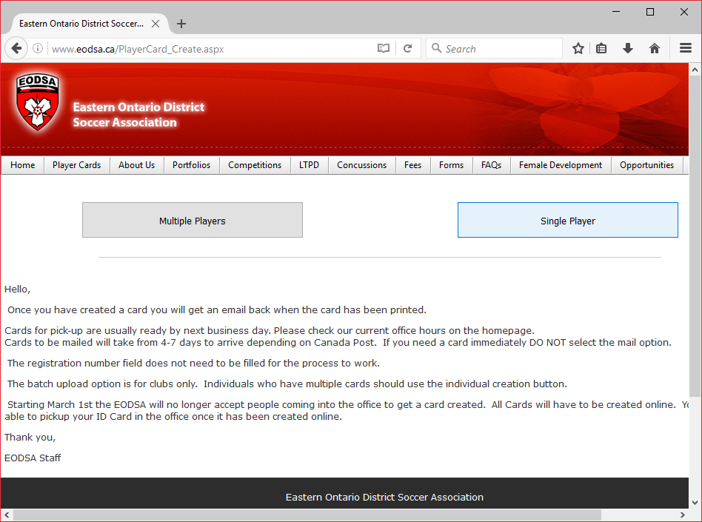
How to Apply for an EODSA Player Card
Click on Single Player

Slide 19
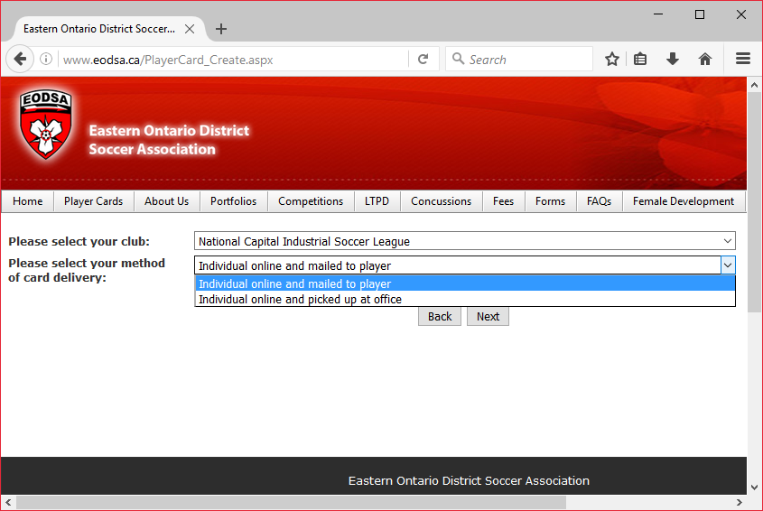
How to Apply for an EODSA Player Card
Select the Club as NCISL
For delivery method you have 2 choices – mailed or pick up
Choose one and click next

Slide 20
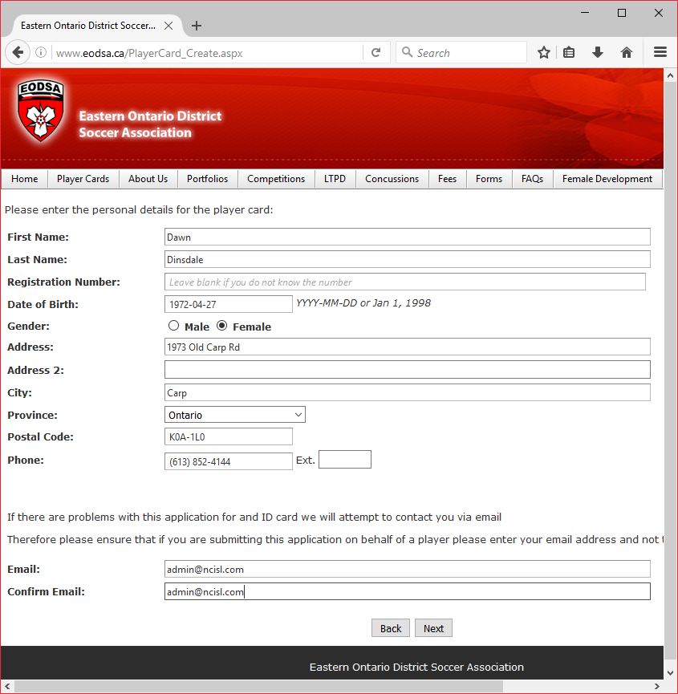
How to Apply for an EODSA Player Card
Fill out all required information.
If you do not know your registration number you can leave it blank.

Slide 21
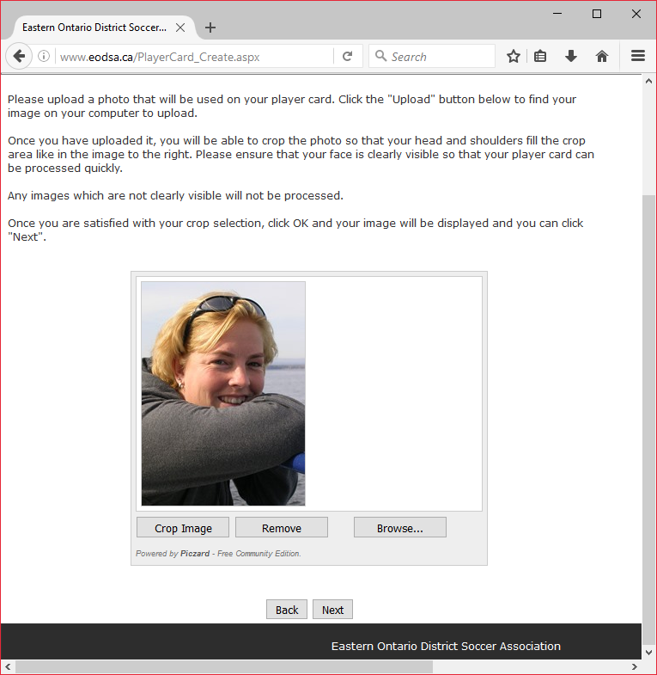
How to Apply for an EODSA Player Card
Upload your picture.
You can take a selfie and use that or a clear picture of yourself.
This example would not be acceptable as my face is partially covered.
Click next

Slide 22
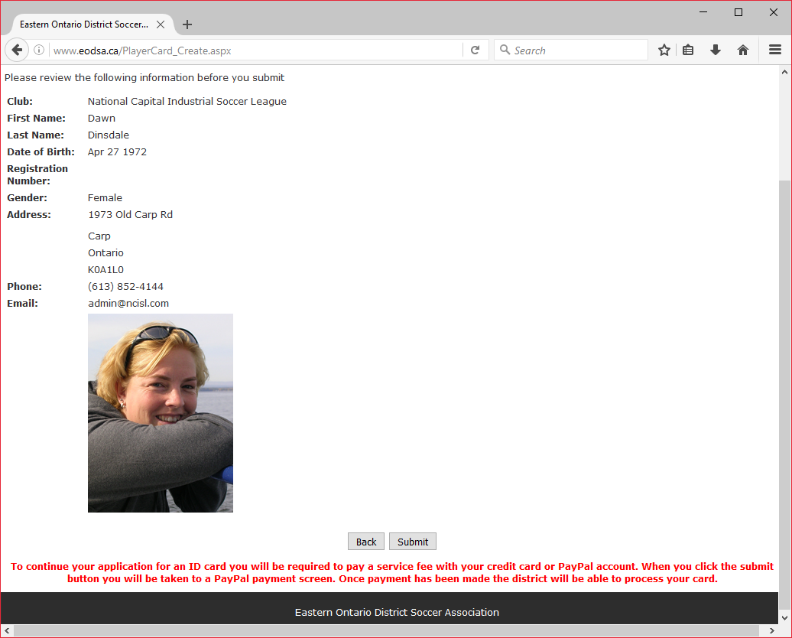
How to Apply for an EODSA Player Card
Summary page
Make sure your information is correct
If your information is correct click submit.

Slide 23
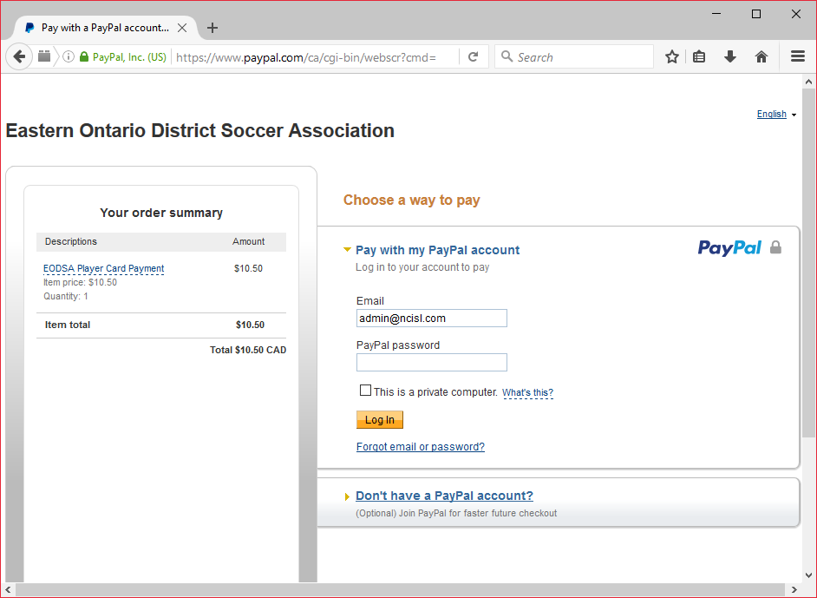
How to Apply for an EODSA Player Card
Note that the NCISL does not pay for player cards.
You can pay through PayPal or credit card.
If you do not have a PayPal account, click here to pay by credit card.

Slide 24
How to Apply for an EODSA Player Card
The EODSA gets very busy closer to season start – DO NOT DELAY in applying for player cards.
EODSA player cards will be the only accepted ID once the regular season starts

Slide 25
Player Eligibility
2. Eligibility policy for players are registered in other leagues Players may be registered with NCISL teams according to the league bylaws and the following policy NCISL Men Divisions 1 and 2 Players registered in the following divisions can not be registered as players or play on a TRP in the NCISL. OCSL Men Premier or any league higher than this on the OS pyramid OCSL Men C1 ERSL Men Under 21
NCISL Men Divisions 3 and 4 Players registered in the following divisions can not be registered as players or play on a TRP in the NCISL. OCSL Men/Women’s Premier OCSL Men C3 OCSL Men C1 OCSL Men C4 OCSL Men C2 OCSL Men C5

Slide 26
Player Eligibility Women’s Division
Players registered in the following divisions can not be registered as players in the NCISL.
OCSL Women Premier or any league higher than this on the Ontario Soccer pyramid

Slide 27
Promotion & Relegation for 2018
Division | Promotion | Relegation
1 |  | Last Place
2 | 1st Place | Last Place
3 | 1st & 2nd Place | Last Place
4 | 1st & 2nd Place
Women 1 |  | Last Place
Women 2 | 1st Place

Slide 28
Rule Proposal – Playing for 2 teams
Current Rule
Rule 4 Player Registration
All players shall be registered with the League in accordance with the current seasons registration policy.
All players shall be at least 18 years of age.
A player may not register with more than one NCISL Men’s team except as defined in that seasons Registration Policy.
Proposed Rule Change
A player may register for a maximum of 2 teams within the NCISL
A player cannot play for 2 teams in the same division
A player registered in Division 1 is not eligible to play in Division 4
A player who is registered to 2 teams within the NCISL may only play for 1 team in the Challenge Cup and 1 team in the President’s Cup competition.

Slide 29
Cups
Challenge Cup – open to all men’s teams (Division 1 – 4)
Presidents Cup – open to all men’s teams in Division 3 & 4
Cups are played as a single game elimination and scheduled throughout the season
Tie breaking process
Penalties from the mark
Cup final will have 2 x 10 minutes, golden goal
Semi finals and finals will be played at the Richcraft Recreational Complex turf field with Assistant Referees for the games

Slide 30
NCISL Game Process
Bring 3 copies of the game sheet with you
Give 3 copies to the referee – referee will return 2 at the end of the game
Each team must provide a goal net and a set of corner flags
Home team provides the game ball
Away team changes if there is a uniform clash
When ARs are provided both teams have their bench on the same side
When no ARs are provided
home team decides which side to place their bench
away team takes other side
you do not change your bench at half time
Collect your completed game sheet from the referee at the end of the game and use it to enter a game report on the NCISL web site

Slide 31
Player Card Inspections
Player card inspections are mandatory and must occur prior to kick off
Failure to perform a player card inspection will result in a fine of $50
The Referee is now responsible for doing card inspections.
Players without a card can not play – no exceptions
Players who arrive late must show their cards to the Referee at half time
Players arriving after the 2nd half has started can not play

Slide 32
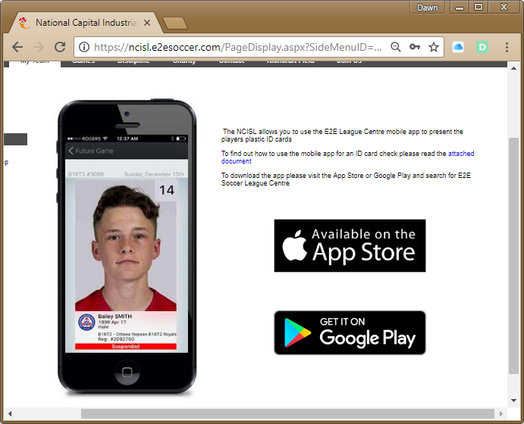
NCISL Player Card App
Team Officials can use the E2E League Centre app to show player cards
Review the document here for exact instructions.

Slide 33
Discipline Process
The NCISL uses the Ontario Soccer Discipline Process
Discipline by hearing
Discipline by review

Slide 34
Discipline by hearing
You can not appeal a red card, instead you can request a hearing
A hearing costs $50 and must be requested in writing within 72 hours of the game
If you are found not guilty you will have your $50 refunded
You will be asked to meet a panel who will decide what action to take
You must attend the hearing
Decisions made by hearing may be appealed to the EODSA according to your rights of appeal (see web site under About section)

Slide 35
Discipline by review
If you do not request a hearing within 72 hours then the discipline by review process will be used
You will be issued the mandatory minimum suspension identified by the OS
You will also be fined $50 and are not eligible to play until this fine has been paid.
You can not appeal a decision made by discipline by review

Slide 36
About Discipline Index
A Discipline Index is used to help maintain an enjoyable and sporting environment for all NCISL members.
A team’s Discipline Index will determine whether or not their application into the NCISL league will be accepted, accepted with sanctions, rejected or possible expulsion from the league
Due to the increased numbers of cards last season and competitiveness of players, the NCISL BoD has decided that the DI will be a floating index determined prior to the start of the season. This index threshold based on last years DI. All teams that have a Discipline Index greater than 0.70 will be on Performance Bonds (PB). This adjustment of 0.20 over last year’s DI numbers will also be reflected in the PB return which has decreased to 0.60. A team on PB must reach a DI of 0.60 to receive a refund of their PB.
All teams will start at the YR1 level of the Performance Bonds
Each Club in the NCISL should be striving to be in the Green Zone of the Discipline Index.

Slide 37
How to determine your Discipline Index?
1 red card = 2 points
1 yellow card = 1 point
Divide the total points by the total number of games that your team plays in the league during a season. This includes cup games.
IE: A team plays 20 games in a season obtains 2 red cards and 15 yellow cards. Their Discipline Index= (4+15)/20
The Discipline Index for this team is equal to 0.95

Slide 38
Discipline Index
Red Zone
0.7 and above
$100 for every 0.10
Warning Zone
0.6 – 0.69
Green Zone
0.01 – 0.59

Slide 39
Referee Complaints
Each season, the NCISL receives several Referee complaints
The NCISL Director of Referees will review each complaint and will respond to the person making the complaint, within 14 days
If required, the Director will speak to the Referee involved in the complaint to obtain their view of the situation
The Director will then determine if the complaint is justified or not
If the Director determines the Referee requires more education in applying the Laws of the Game, he will speak to the Referee personally
If the Director concludes the Complainant needs an explanation of the Laws, as the Referee was correct in applying the Laws, he will communicate directly with this person
Any serious misconduct by a Referee, who contravenes any of the OSA published rules, and a complaint is received by the NCISL, will be forwarded to the EODSA Referee Discipline Committee for further action

Slide 40
Further information
Dawn Dinsdale, admin@ncisl.com 613-852 – 4144
Andy Weston, Head Referee – referee@ncisl.com
Tim Wong, Director of Discipline – wongtim10@gmail.com
Or check out our web site www.ncisl.com

